Slide 1
CS 6381 Final Project
Google Cloud Pub Sub
James Vu | Jordan Smith | Brant Kyser

Slide 2
References
Code, documentation, data, references, etc. at: https://github.com/jamesvu1/cs6381finalprojectgooglecloudpubsub
Disclaimer: This repository was completed based on our overall understanding of the experiment instructions and what we knew/found through our efforts/attempts given the time we have had.

Slide 3
Overview
Built a Pub-Broker-Sub type of app implementing Google Cloud Pub Sub API-based code, Python, and ZMQ
Data flow:
pub.py: Send messages to Broker via ZMQ continuously.
broker.py: Receive messages from Pub via ZMQ and send messages to Sub via Google Cloud Pub Sub continuously.
sub.py: Receive messages from Broker via Google Cloud Pub Sub and when a specified number of messages have been received, save the messages into CSV.
Message contains message ID and times it took to get from Pub to Broker and from Broker to Sub.
clear.py: Clears old messages that sub.py would have received via Google Cloud Pub on the next run.
calculateStatistics.py: Read the data from “tm” (time measurement) CSV files and save a CSV filled with statistics (e. g. min, max, average, standard deviation)
hardwareMeasure.py: Continuously see the latest hardware statistics (CPU, RAM, storage)

Slide 4
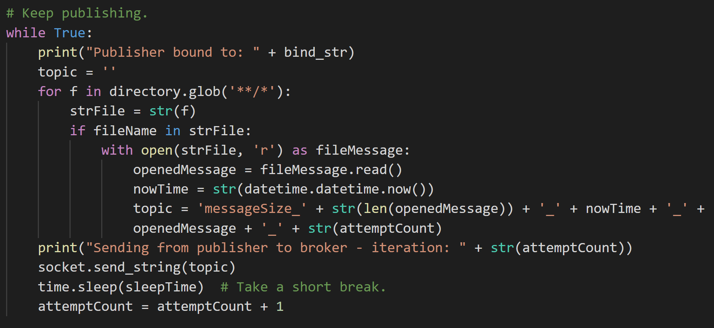
Code – pub.py

Slide 5
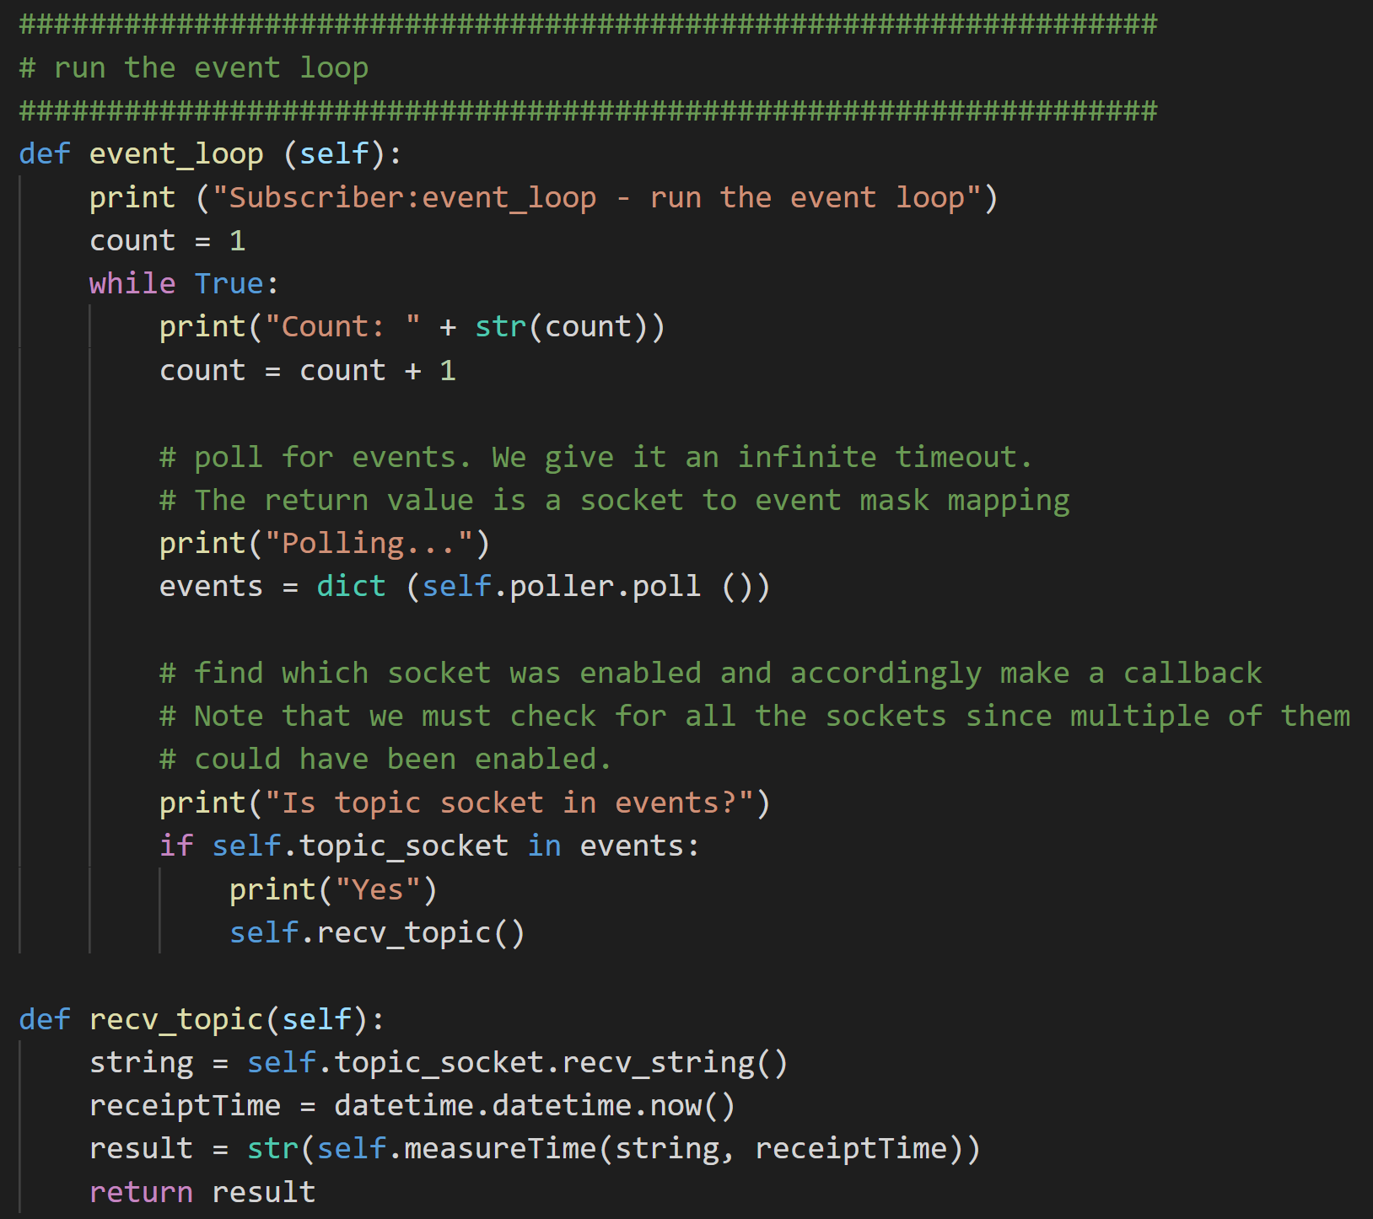
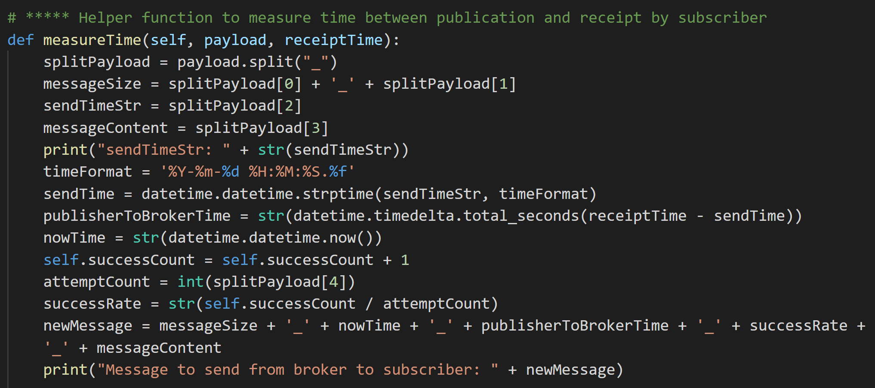
Code – broker.py
* newMessage is converted into a form that can be sent via Google Cloud Pub Sub (code in repository as linked earlier due to copyright reasons).

Slide 6
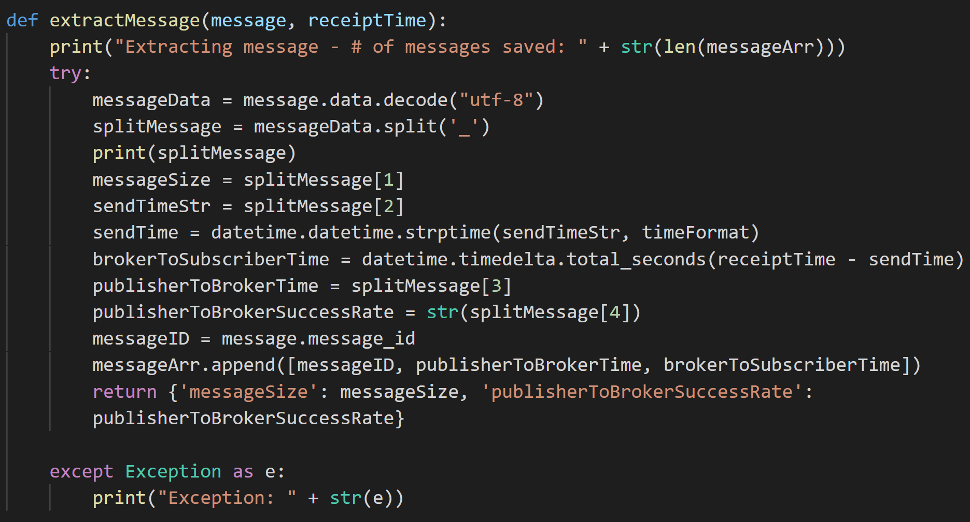
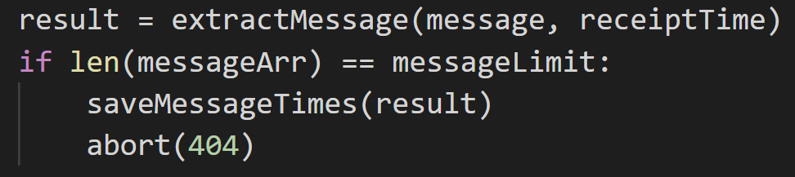
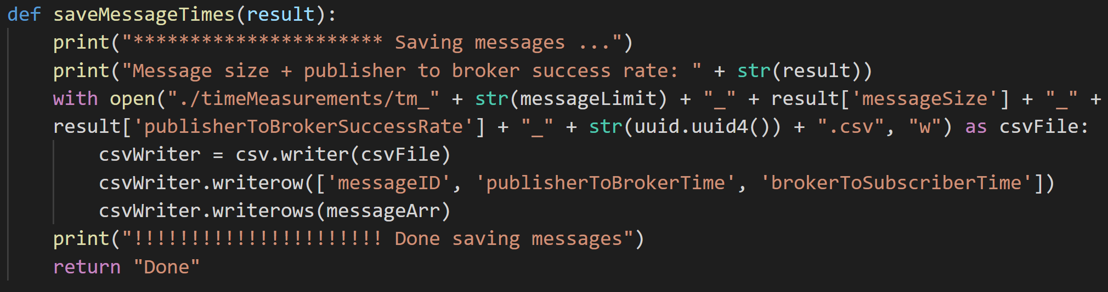
Code – sub.py
* Message is received from Google Cloud Pub Sub (code in repository as linked earlier).

Slide 7
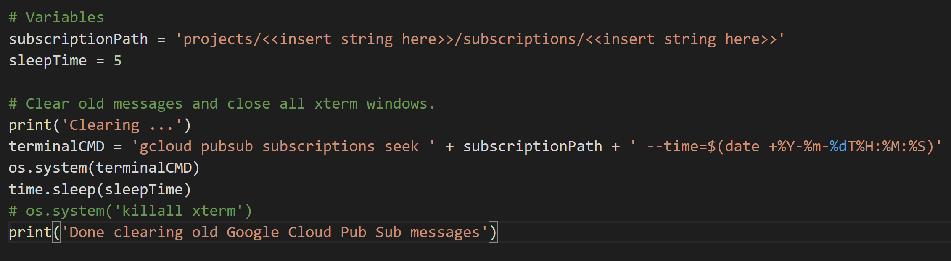
Code – clear.py

Slide 8
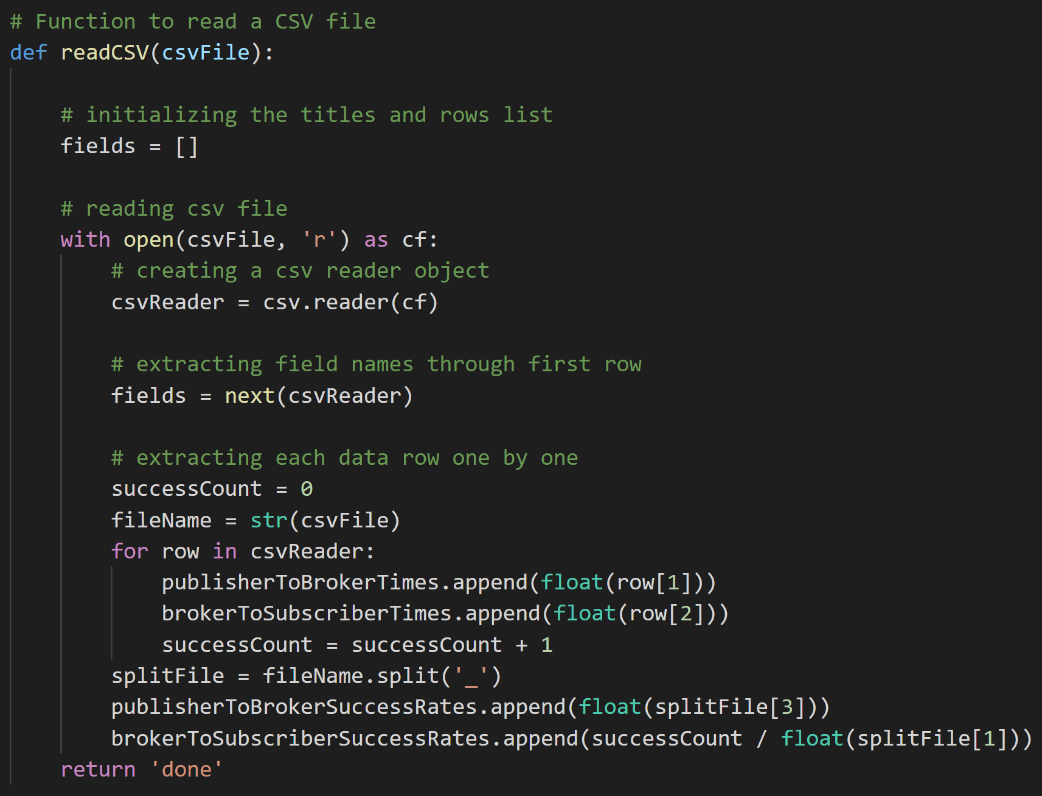
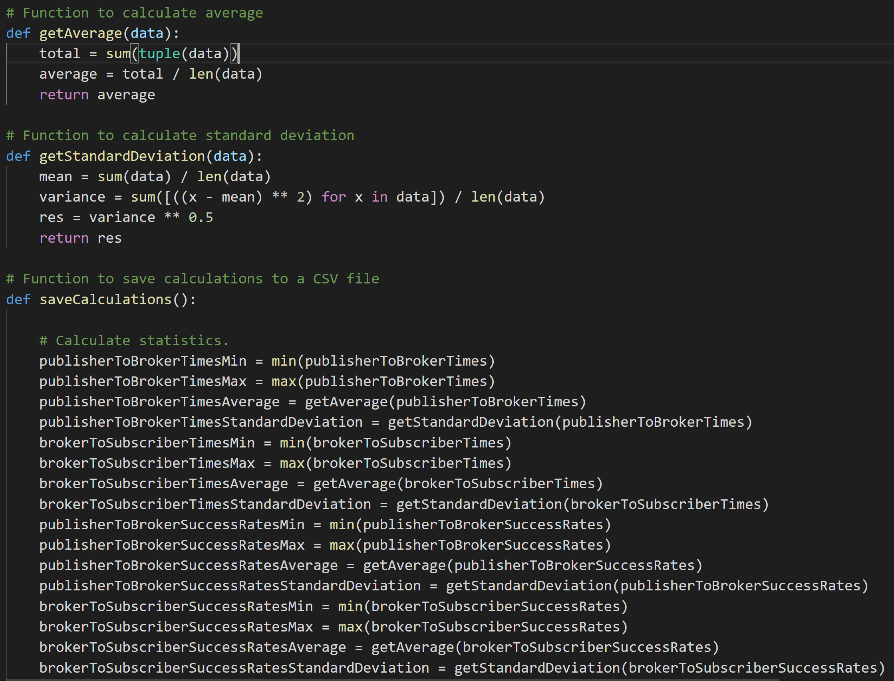
Code – calculateStatistics.py

Slide 9
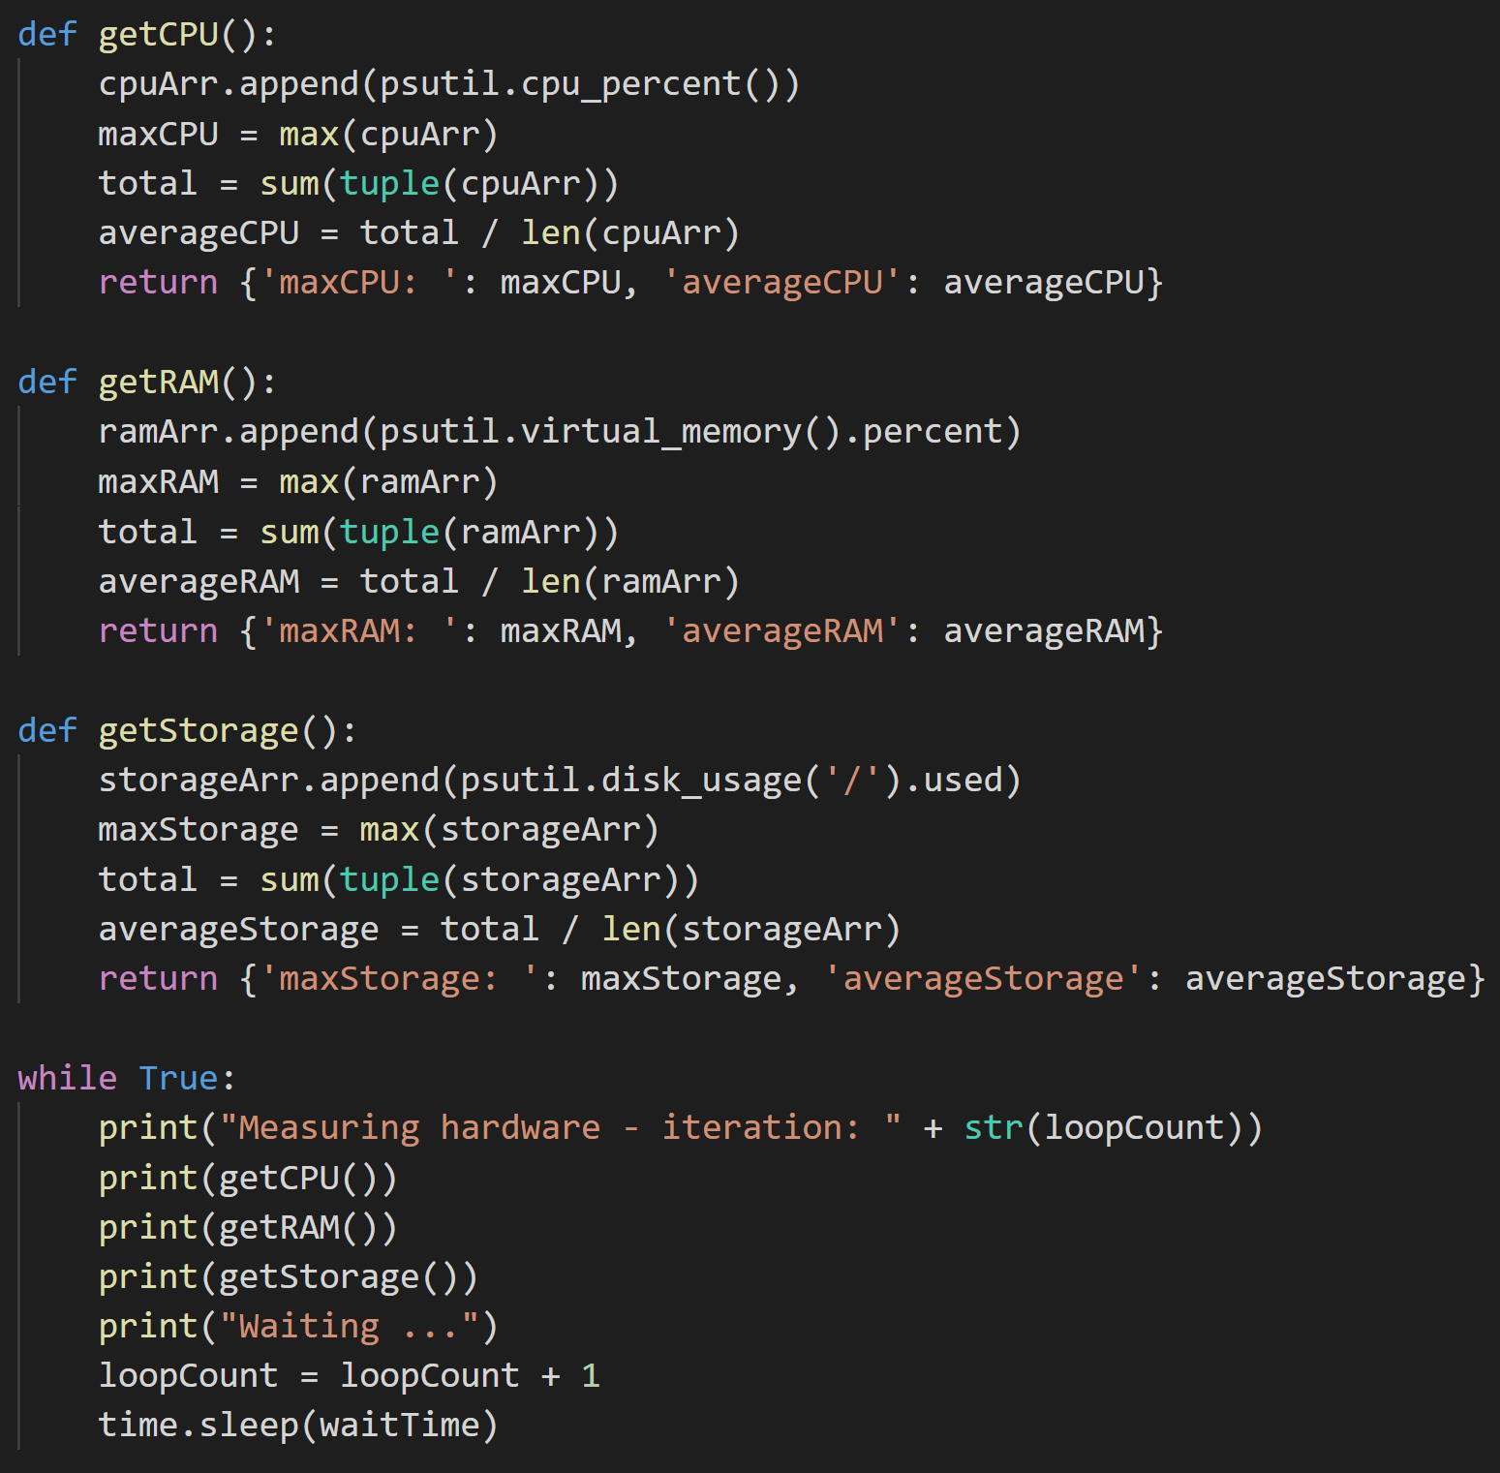
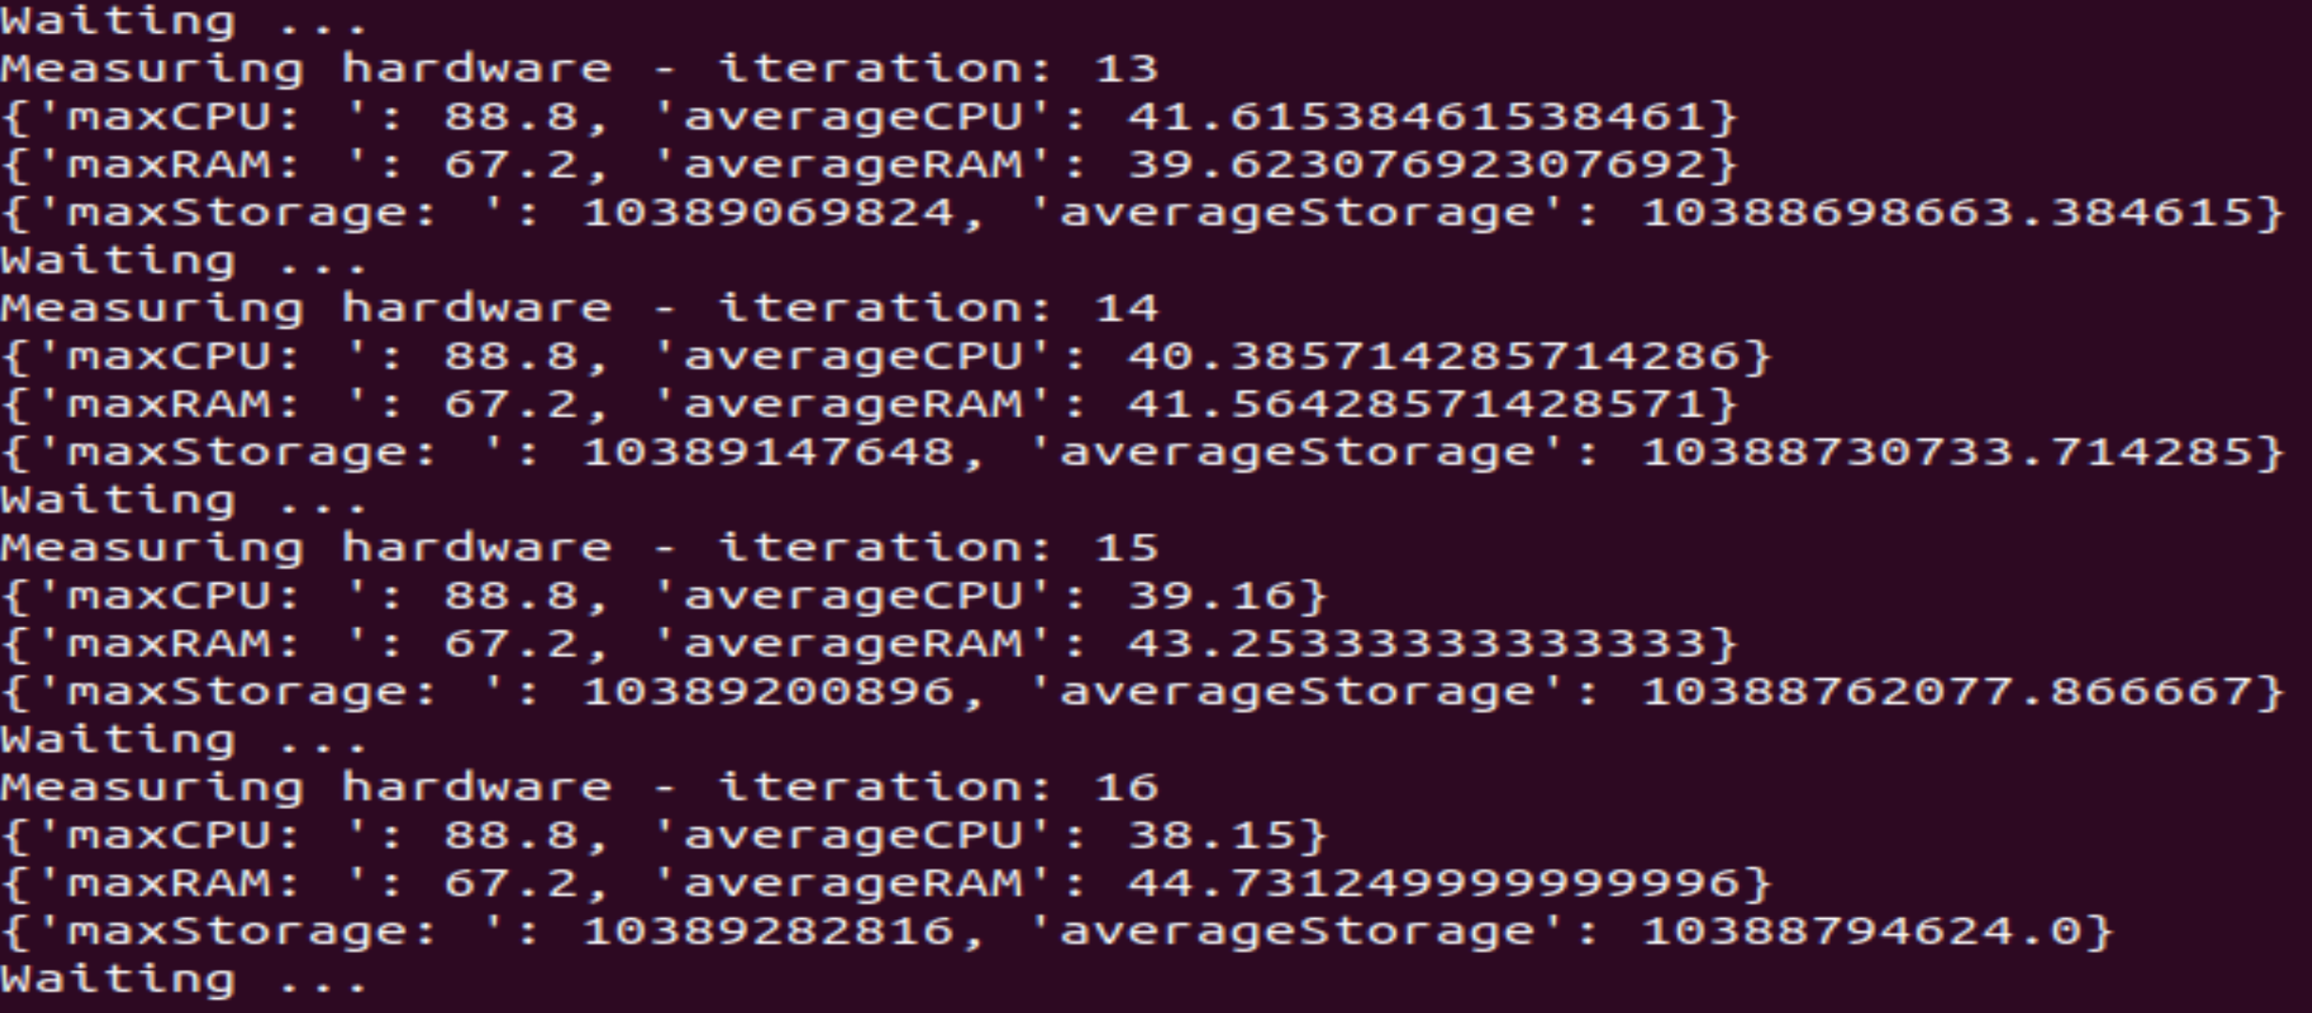
Code – hardwareMeasure.py

Slide 10
Setup
Create Google Cloud publisher and subscriber topics on their UI.
Have a local setup for integrating Google Cloud with Python. For our demo, we used Ubuntu 18.04 and Python3.
Install Google Cloud SDK on Ubuntu.
Git clone the Google Cloud Pub Sub repository. The quickstart folder contains code for sending and receiving messages via Google Cloud Pub Sub.
Before running the code, put `` like where it shows export PROJECT=`gcloud config get-value project`
Rename your JSON key to something simple like key.json and put it somewhere simple to access like in the Downloads folder with respect to the root folder.

Slide 11
Run Code to Get Time Differences CSV Data
Automatically
Navigate to the tests folder
Run a test using “./{{test name}}” (e. g. “./1producer1consumerTest.sh”).
Wait until the test finishes (i. e. when all extra terminal tabs have closed [the last one takes a little while to show up]) and then check for results in the timeMeasurements folder.
Manually
Open 3 separate terminals or tabs and run each of the following separately in this order, applying the “Connect to Google Cloud Project” step as follows at the start of all the subsequent steps (sub.py, pub.py, broker.py).
Connect to Google Cloud project.
export GOOGLE_APPLICATION_CREDENTIALS=~/Downloads/key.json
export PROJECT=`gcloud config get-value project`
echo $PROJECT (make sure project ID shows up)
Run sub.py:
“python3 sub.py $PROJECT {{Google Cloud-created subscription name (e. g. sub_one)}}”
Run broker.py:
“python3 broker.py $PROJECT {{Google Cloud-created topic name (e. g. hello_topic}}”
Run pub.py:
"python3 pub.py {{file name}}“

Slide 12
Stop the Run
To stop the code properly using Ctrl + C:
Stop broker.py 1st or else sub.py will receive old messages.
Empty out old messages by 1 of the following ways:
Run “python3 clear.py”.
Start sub.py and wait until all old messages are emptied out and then stop it before running the code again.

Slide 13
Run Code to Collect Statistics
Run calculateStatistics.py to calculate statistics of time measurements.
You can measure hardware performance continuously by running hardwareMeasure.py, which will print the latest information.

Slide 14
Conditions Tested
Treated Google Cloud Pub Sub message sender (i. e. broker.py) as producer and Google Cloud Pub Sub message receiver (i. e. sub.py) as consumer
Tests accounted for messages of different lengths
1 producer vs. 1 consumer
1 producer vs. 5 consumers
5 producers vs. 1 consumer
3 x (8 producers vs. 8 consumers)
4 x (25 producers vs. 25 consumers)

Slide 15
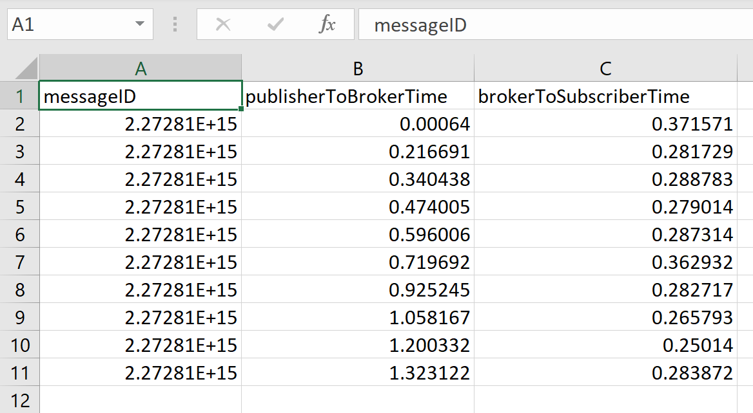
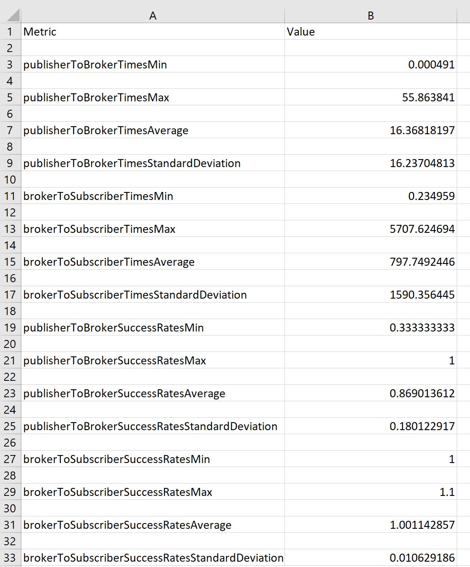
Result Format
Time Measurements CSV
Calculations CSV

Slide 16
Base File - Basics
How many individual actors can connect to this system at one time? One connection per subscription name. Multiple connections into a publication name is okay.
What license does it operate under? Creative Commons Attribution 4.0 License, Apache 2.0 License
How much must be paid to use this technology? Need lots of requests to be expensive
Does it have explicit enterprise support? A person may be able to contact Google Cloud.

Slide 17
Base File – Compatibility
OS
Yes
Ubuntu
Windows
Mac
Docker
Maybe
Raspbian
CPU
Intel
AMD
Language
Yes
Python
JavaScript
C++
C#
Java
Go
Ruby
PowerShell
Rust
Maybe
Kotlin
Perl
Elixir

Slide 18
Base File - Hardware Needs
 | CPU | RAM | Hard Disk Memory
Idle | 0.13999999999999999 | 92.6 | 10382614528.0
Max Observed Under Load A | 77.2 | 98.7 | 10388865024
Average Observed Under Load A | 17.043999999999997 | 90.60399999999998 | 10382843412.48
Max Observed Under Load B | 88.8 | 67.2 | 10389282816
Average Observed Under Load B | 38.15 | 44.731249999999996 | 10388794624.0

Slide 19
Qualitative Data
Metric | Value
Centricity (data-centric or message-centric) | Message-centric. Decoupled, asynchronous messaging service
Connection (machine-to-machine or point-to-point) | Point to point since communicate using multiple terminals on the same computer
Underlying Architecture (decentralized or hub-and-spoke) | Hub and spoke. You can make a VPC (Virtual Private Cloud) in Google Cloud and connect to other projects/resources.
Protocol | HTTP
Transport(s) | Google Cloud Pub Sub handles TCP and UDP when it comes to load balancing. Messages received from Google Cloud Pub Sub can be sent to an application that utilizes a protocol like TCP or UDP (e. g. a Python message sending/listening application). HTTP

Slide 20
Qualitative Data
Metric | Value
Data Serialization | Data input into Google Cloud Pub Sub must be in JSON format.
Supports Queuing | Publisher makes and send messages to a topic with data, ordering key, and metadata. Subscribers have message ordering property option.
Data Type Representation | JSON that contains various data types such as string and TimeStamp
QoS Parameters | You can send messages through MQTT bridge to Cloud IoT core, which supports multiple QOS levels.
Supports Dynamic Discovery | Google Cloud Pub/Sub dynamically tweaks publishers and subscribers based on message throughput.
Communication Patterns | Subscriber push/pull Streaming pull, push/pull

Slide 21
Qualitative Data
Metric | Value
Abstraction Layer | For abstraction of implementation details, there exists a service proxy among clients and data senders that helps optimize connection for clients. The control plane assigns the publishers and subscribers to the servers. The data plane handles message transmission among publishers and subscribers.
Up-front Complexity | Option of Pub/Sub Lite Quotas and usage Horizontal scalability (add more devices) Publish with error handling Redundancy, rollback, traffic limit, recovery, failure detection, incremental changes, coordinate/document emergency response, capacity management Failed publications are retried automatically.
Large Implementations | Google Cloud Pub Sub has certain max limits such as 10000 topics per project, 10 MB per message, 10 KB per schema, etc. Across a load-balanced set of subscribers, only 1 subscriber can be in a partition at a time. Thus, there is a limit on parallel processing. Possible solution: Put subscriber on topic with more shards but this means more topics to maintain and migration needs to be done more carefully. Implementation • Create Google Cloud account and set up features using website UI. • Set up topic, which 1 publisher detects. • Set up 2 subscribers. • Install Python and Google SDK. • Open 3 terminals for 1 publisher and 2 subscribers. • Messages are published and subscribed efficiently with little delay time in between.

